Slide 1

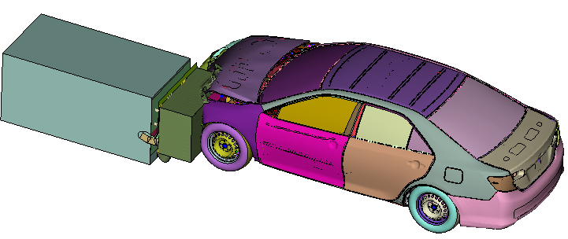
Simulation of process induced deformations of fusion bonded hybrid components and potential analysis in a car model
[5]
Suba Siva Chandran, Kalimuthu, 22.09.2021

Slide 2
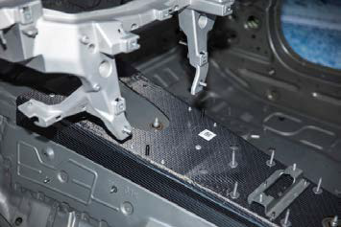
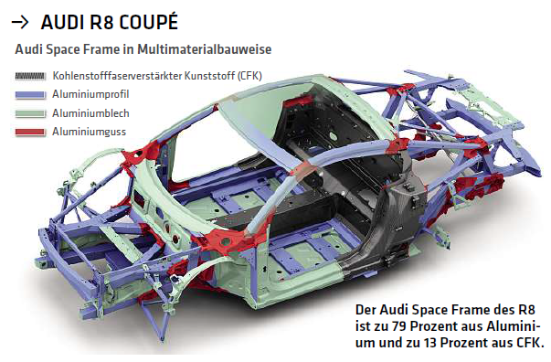
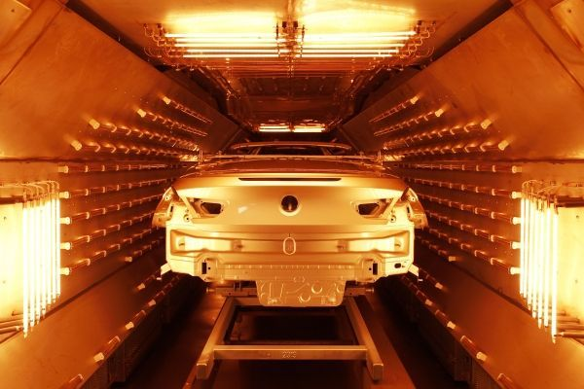
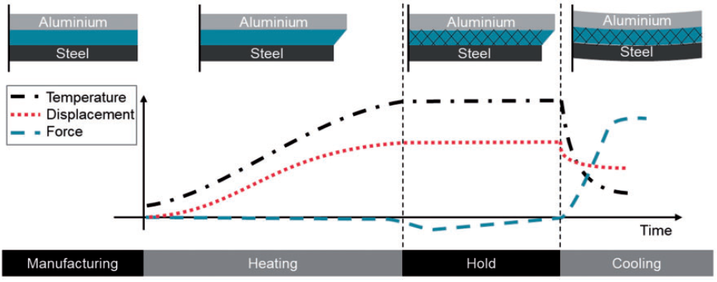
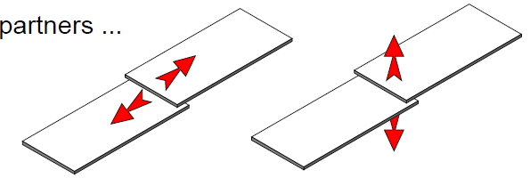
Introduction
Lightweight concept in automotive
Tunnel upper area in BMW M7 [6]
Upper roof rail in BMW M7 [6]
Audi R8 spaceframe rear wall is made up of CFRP and has high tensile strength of about 2000 MPa
[5]
Spaceframe made up of 79% Aluminium and 13% CFRP
Industrial process
Steel – 1.3e⁻⁵
Aluminium – 2.4e⁻⁵
GFRP – 1.77e⁻⁵
[8]
Freshly painted car body positioned in paint-drying oven for curing [7]
Different variables during paint drying process [11]

Slide 3
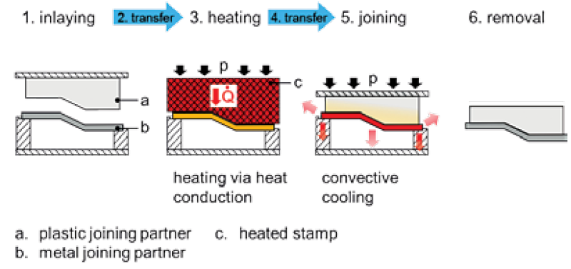
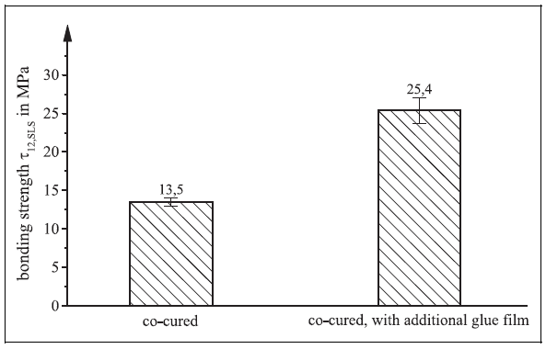
Problem description
What is fusion bonding or co-curing?
Fusion bonding
+
Adhesive joining
with epoxy film
How much would be the strength of the hybrid joint ?
=
Illustration of fusion bonding process [1]
Bonding strength of co-cured vs co-cured with adhesive [2]
Goal:
To devise a process simulation method for fusion bonding incorporated adhesive joining process which involves hybrid materials in the FEM software ABAQUSTM
To predict the stresses in the adhesive layer after the paint dryer process as a result of CTE mismatch

Slide 4
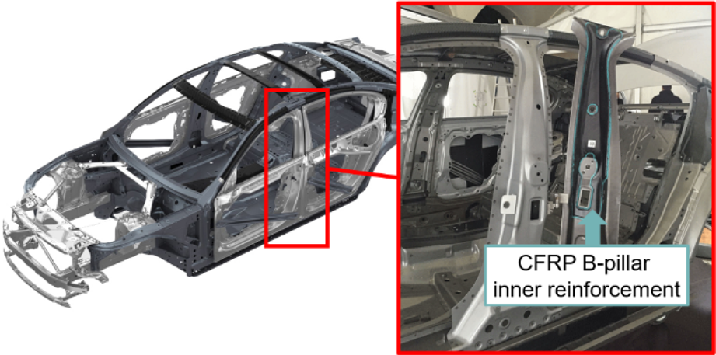
Motivation and Objective
Motivation:
Multi-material system plays a crucial role during crash and a superior choice over traditional metal sheet
Combining the advantages of fusion joining and adhesive bonding methods
To analyze the structural efficiency of the hybrid joint
Objective:
To investigate the influence of thermal expansion coefficients of different materials
To simulate the process and predict adhesive layer damage using FEM software ABAQUSTM
To transfer the process simulation to a potential component in car model
Hybrid B-pillar assembly made of Steel and CFRP in BMW M7 [4]

Slide 5
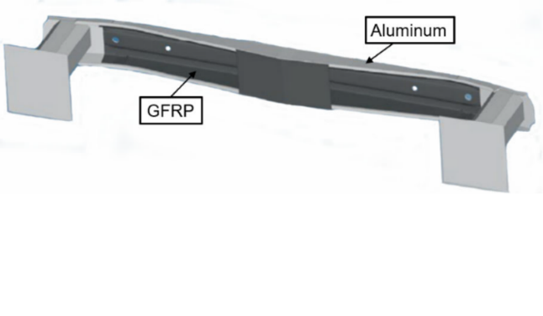
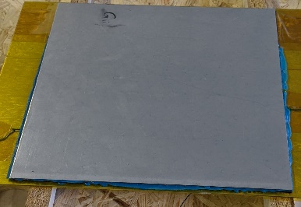
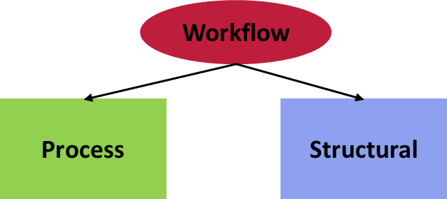
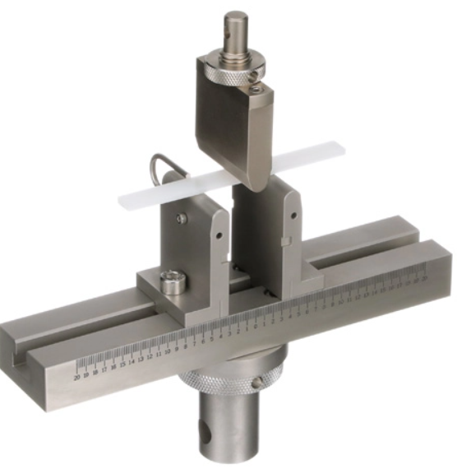
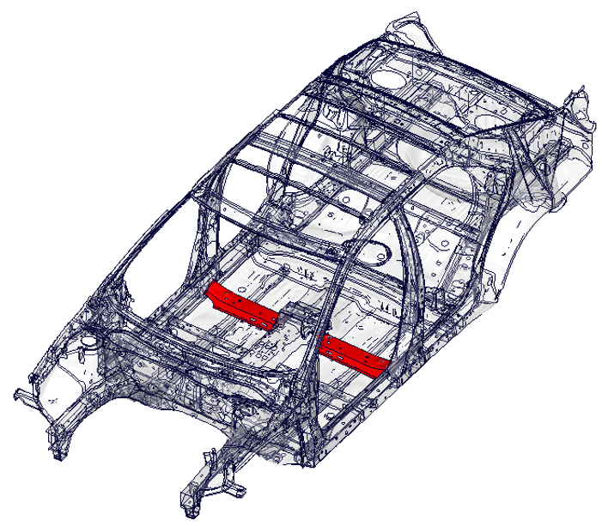
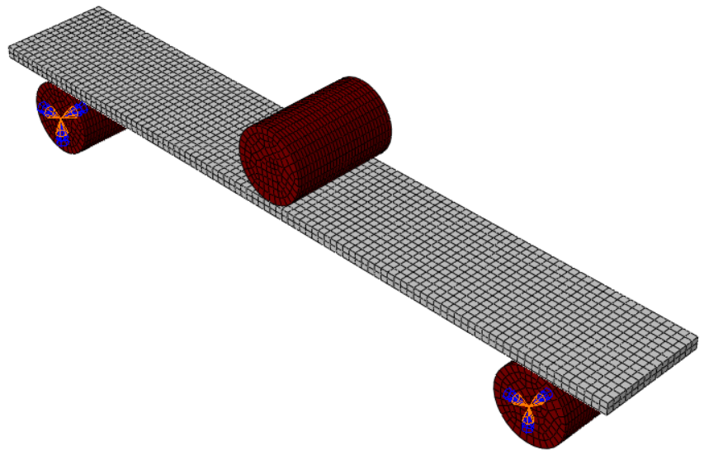
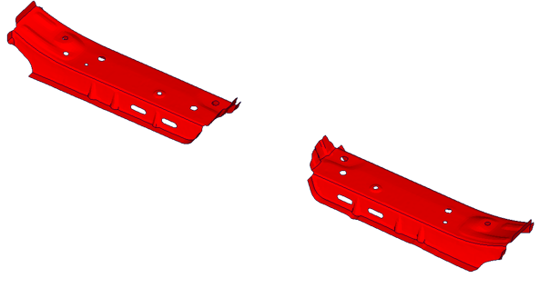
Contents
Hybrid front bumper [3]
Hybrid plate overview and material model requirement
Workflow and Simulation principle
Hybrid plate process simulation
Structural test and its validation
Potential analysis in Toyota Camry
Conclusion and future work
&
What parameter has to be evaluated for cooling process ?
Simulation method transfer
3-point-bend test fixture [12]

Slide 6
Contents
Hybrid plate overview and material model requirement
Workflow and Simulation principle
Hybrid plate process simulation
Structural test and its validation
Potential analysis in Toyota Camry
Conclusion and future work

Slide 7
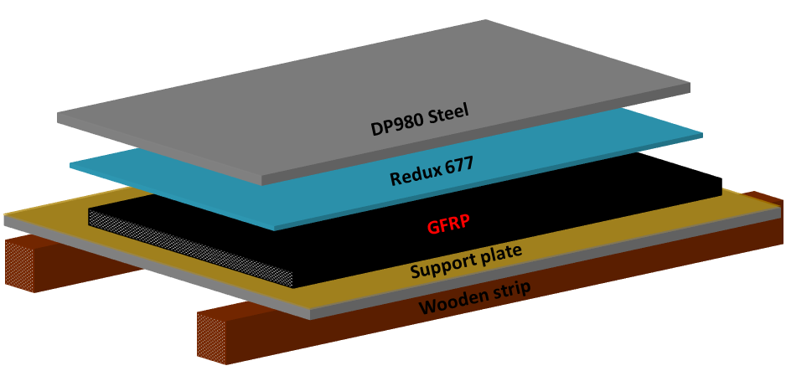
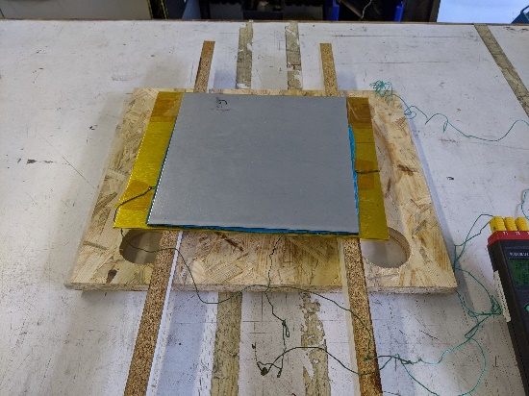
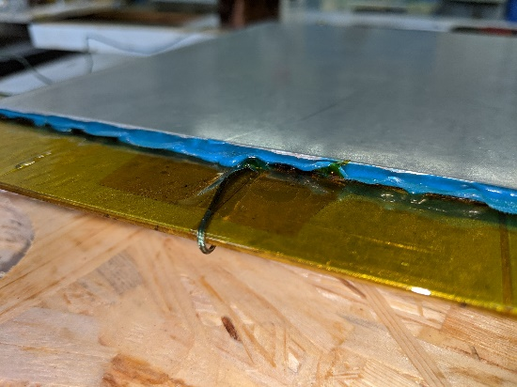
Hybrid plate overview and material model requirement
Steel
GFRP-PA6 (Twill fabric - RG600(x)/47% Roving Glass – PA 6 Consolidated Composite Laminate from LANXESS AG)
Adhesive (Modified Epoxy film adhesive from Hexcel)
Support plate
Thermal properties
ρ, k, c
☑
Film coefficient
☒
Hybrid plate manufacturing setup
☑
Mechanical properties
E, ν, α, ε_{p}
Damage model for adhesive
☑

Slide 8
Contents
Hybrid plate overview and material model requirement
Workflow and Simulation principle
Hybrid plate process simulation
Structural test and its validation
Potential analysis in Toyota Camry
Conclusion and future work

Slide 9
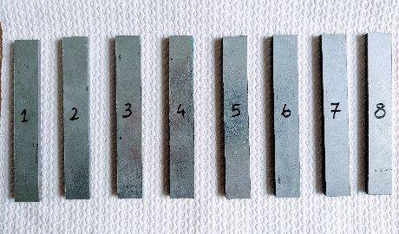
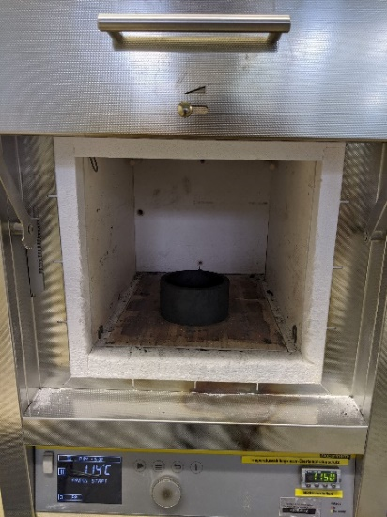
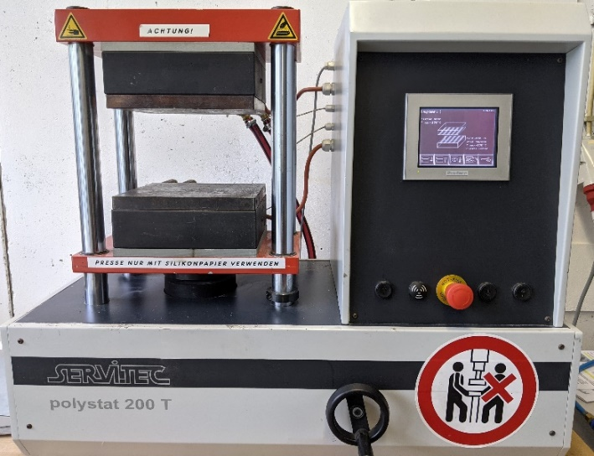

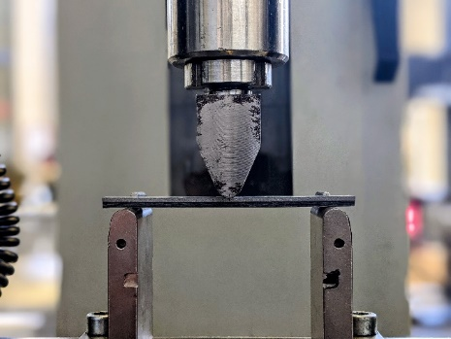
Workflow
GFRP heated above melting point in the oven
Joined together with Steel, adhesive by heat press
Hybrid plate
Allow to cool down from 150°C to RT
Process
Structural
Goal:
To manufacture the hybrid plate and simulate the cooling procedure to evaluate the stresses in adhesive layer as a result of CTE mismatch
To perform the 3-point-bending tests to assess the strength of hybrid joint as it is the common mode of deformation during car crash

Slide 10
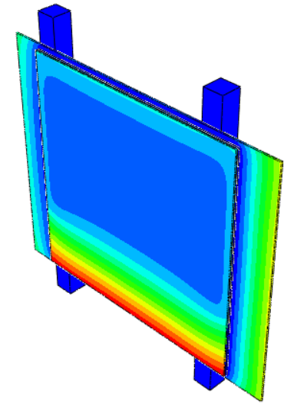
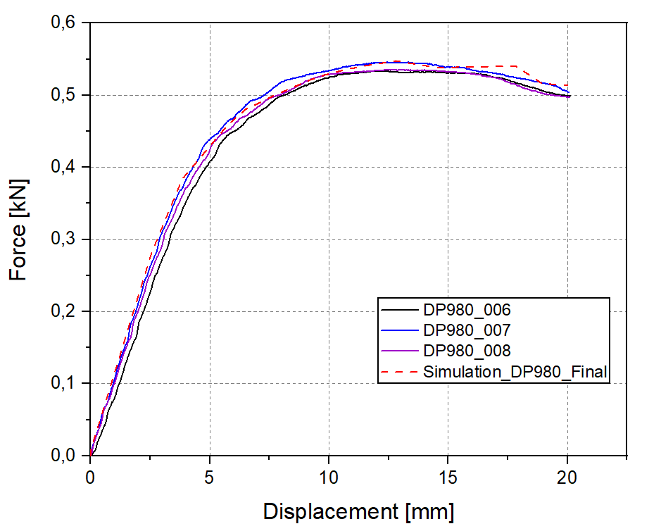
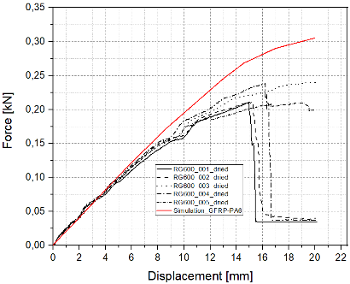

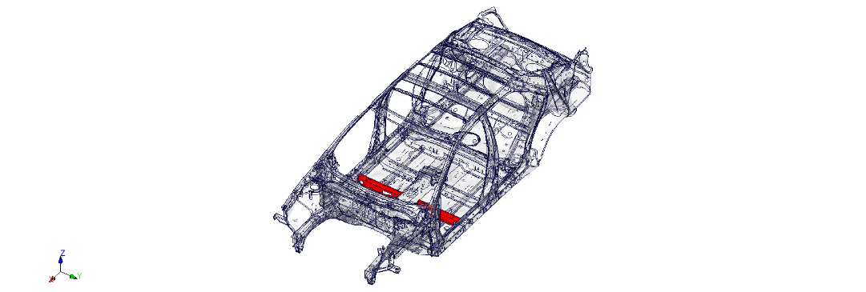
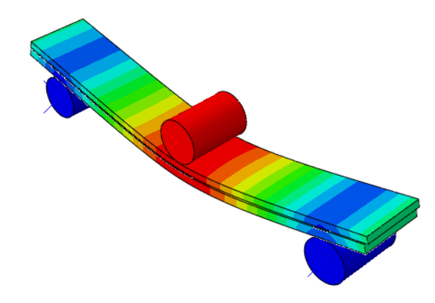
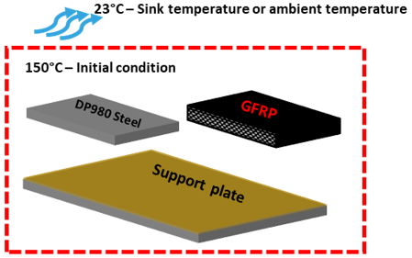
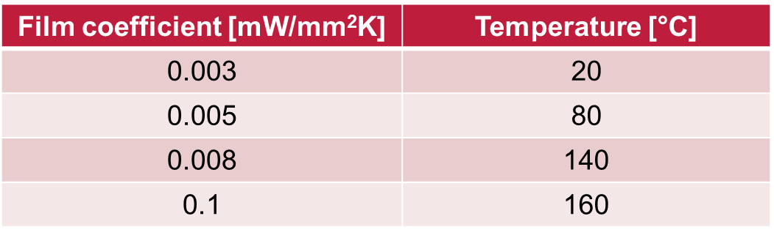
Simulation principle
Temperature recording using thermocouple
Nodal temperature
Process simulation transfer
Displacements
Steel
GFRP
Process
Structural
Goal:
Film condition evaluation must be done to simulate the cooling process

Slide 11
Contents
Hybrid plate overview and material model requirement
Workflow and Simulation principle
Hybrid plate process simulation
Structural test and its validation
Potential analysis in Toyota Camry
Conclusion and future work

Slide 12
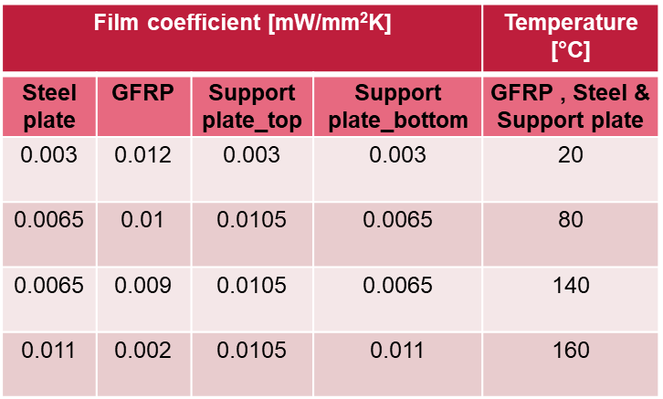
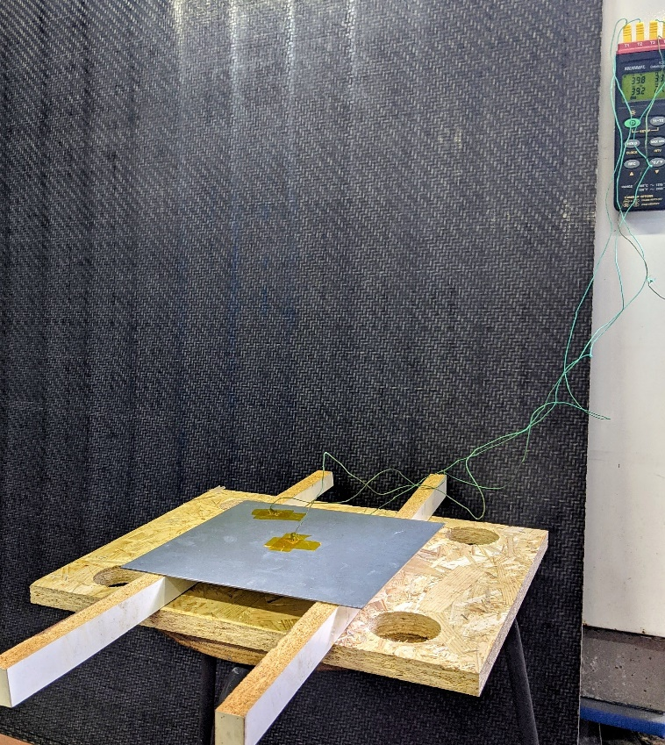
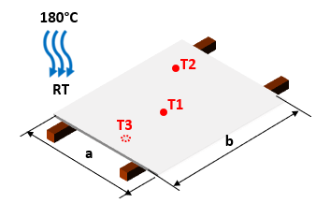
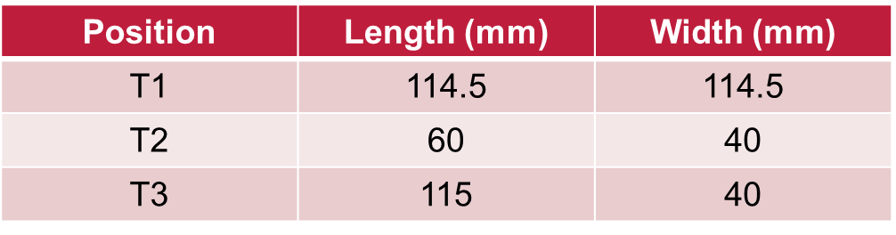
Hybrid plate process simulation
Experimental Method
Free convective cooling of Steel plate
Method
Free convective cooling of CFRP
Steel
Steel
Material
Steel plate (Thickness - 1.63 mm)
Experimental duration
1225 seconds
Temperature
Initial temperature – 180°C
Geometry & Measurement points
a = 229.5 mm, b = 229.5 mm
Film condition obtained for individual components of hybrid plate
Goal:
To record the temperature distribution of the individual components of the hybrid plate and to compare the results with FE results to obtain a justification
Cooling experiment for the Steel component of the hybrid plate

Slide 13
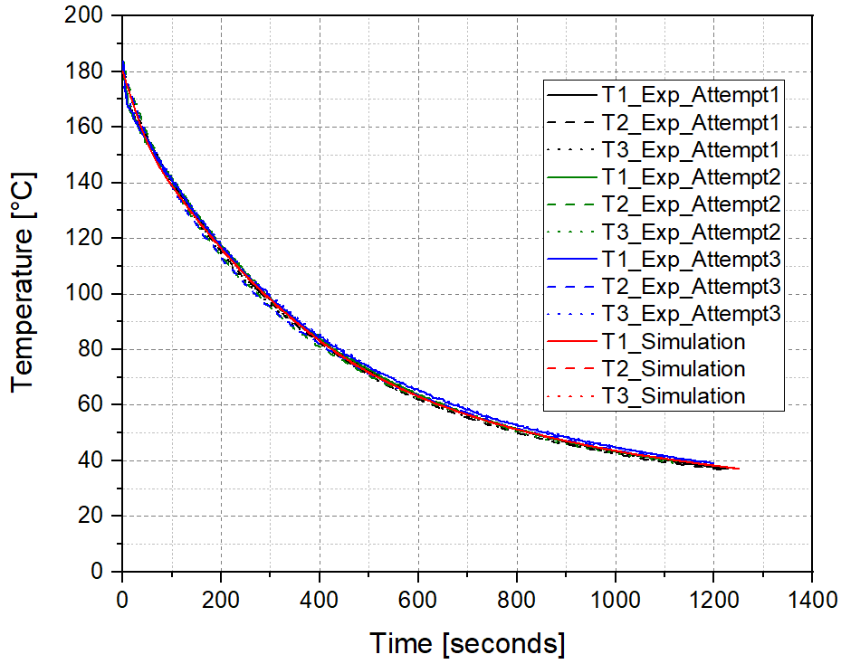
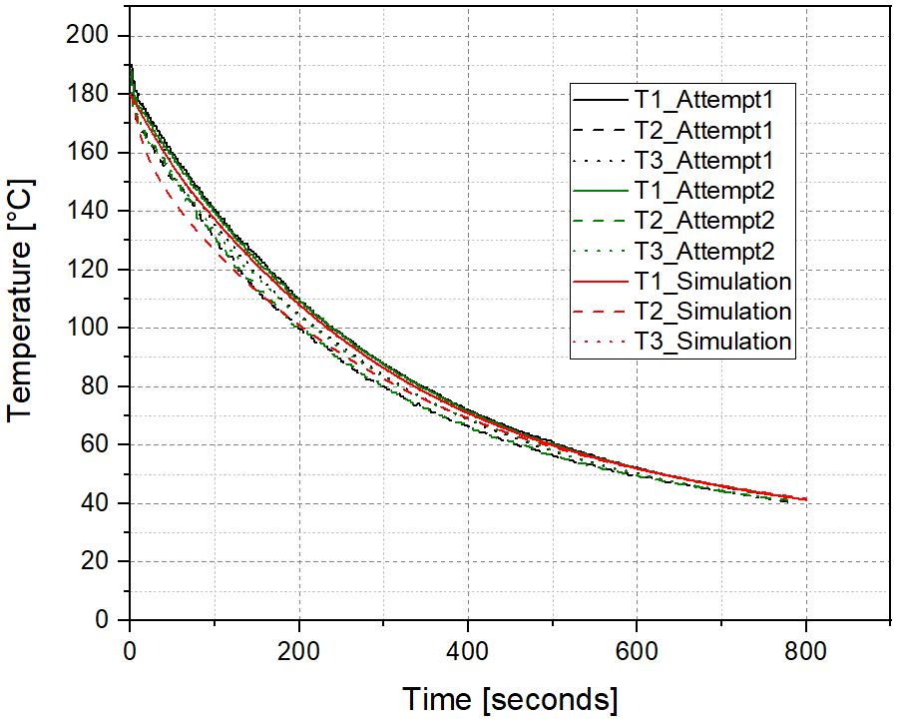
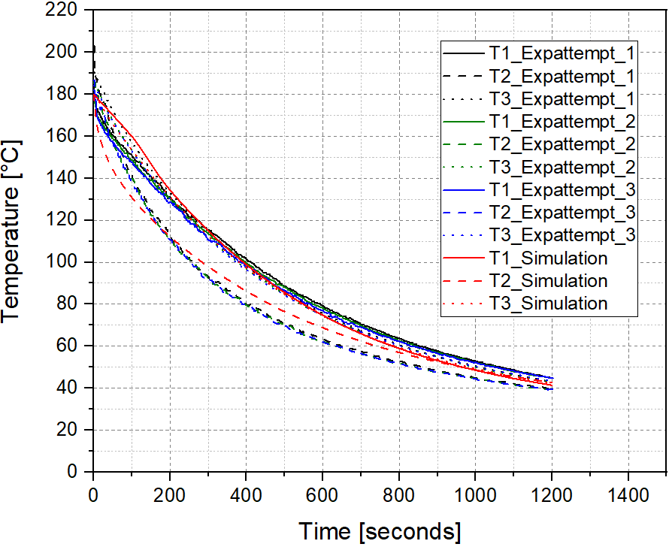
Hybrid plate process simulation
Steel
Support plate
GFRP
The film condition for different components of hybrid plate were validated with the experimental results and found a good correlation and therefore to be used for the process simulation

Slide 14
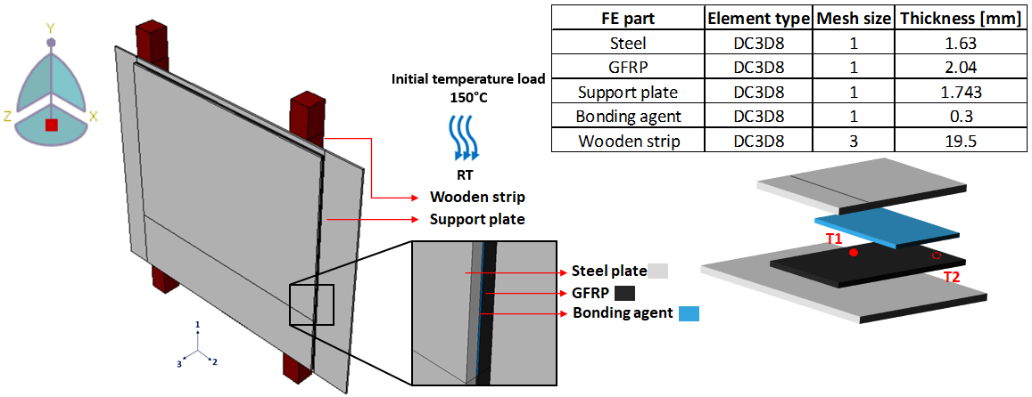
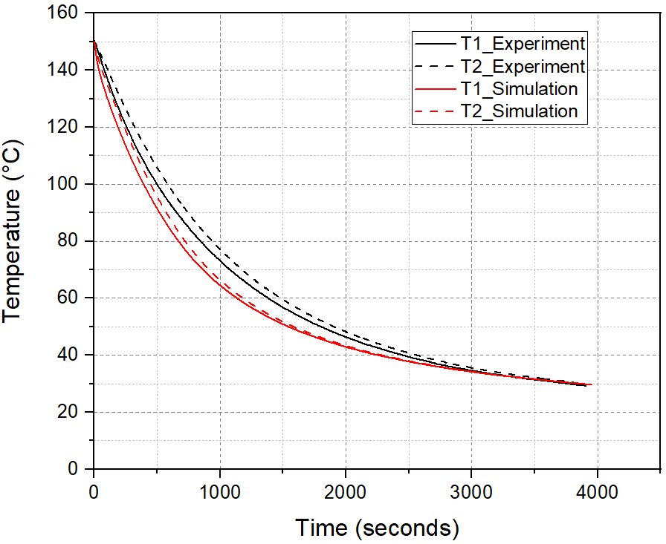
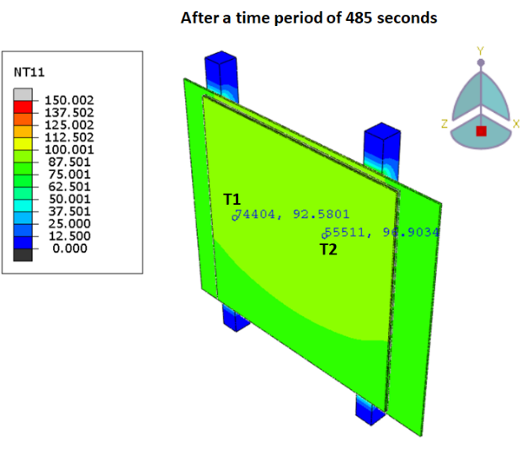
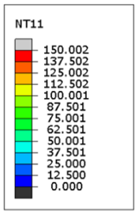
Hybrid plate process simulation – Thermal analysis results
Dimensions: GFRP, Steel – 230 x 230
Adhesive – 230 x 170
Support plate – 300 x 230
After 485 seconds
The temperature distribution on the lower surface of the GFRP is stagnated since it is fixed firmly to the support plate

Slide 15
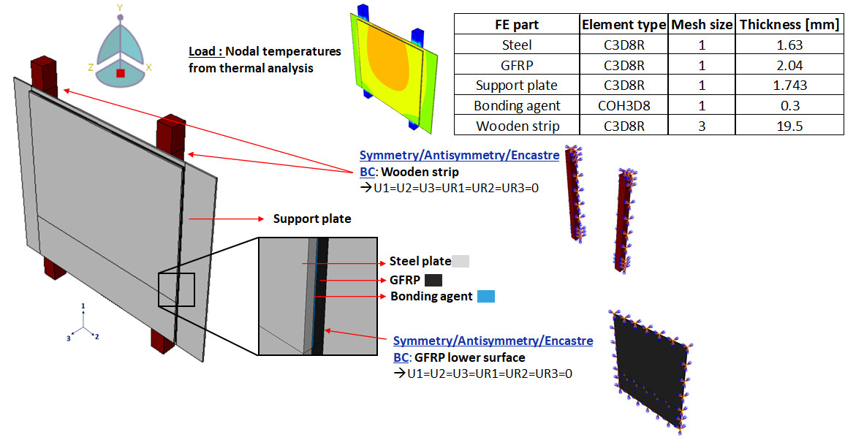
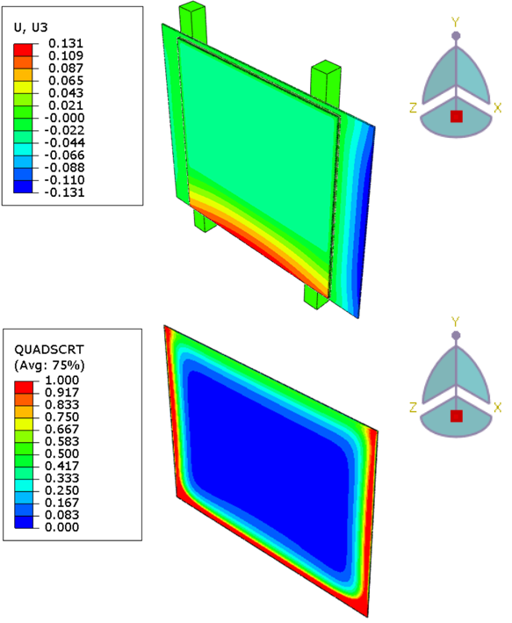
Hybrid plate process simulation – Mechanical analysis results
Steel adherend displaces in out-of-plane direction in production of DCB hybrid plate
An average of 45% stiffness degradation is found within the adhesive
Also, in many regions the damage initiation criterion had already exceeded which indicates that more damage is likely

Slide 16
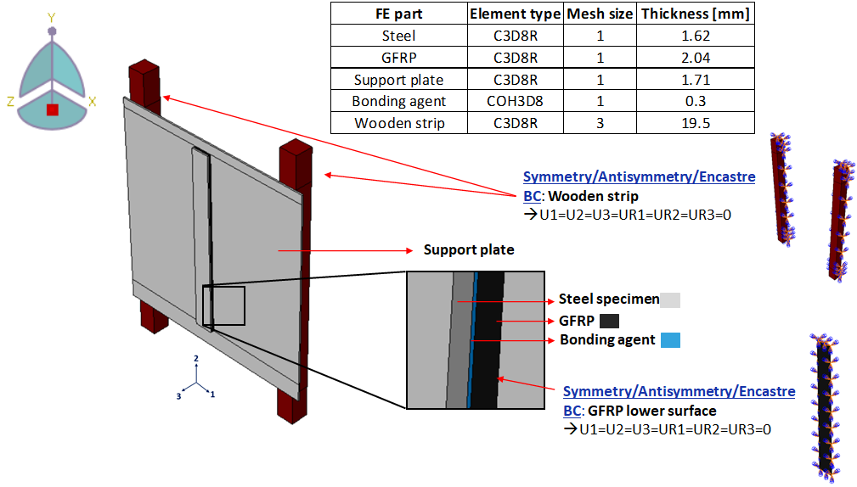
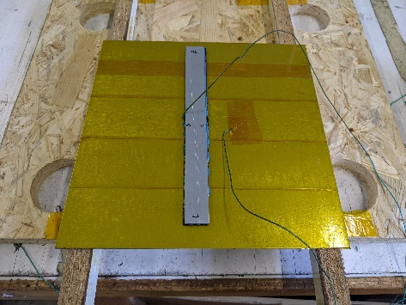
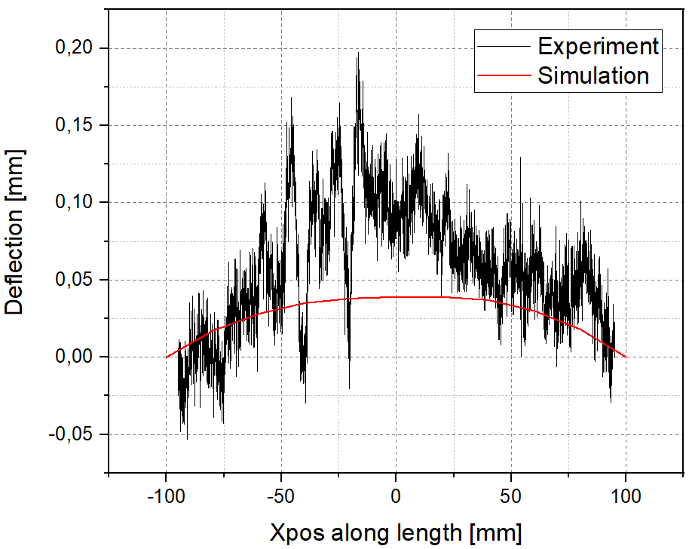
Process validation – Mechanical analysis results
Dimensions: GFRP, Steel, BA – 200 x 20
Support plate – 300 x 230
Experimental setup of process validation
The process has been validated by checking the deflections with the help of linear extensometer

Slide 17
Contents
Hybrid plate overview and material model requirement
Workflow and Simulation principle
Hybrid plate process simulation
Structural test and its validation
Potential analysis in Toyota Camry
Conclusion and future work

Slide 18
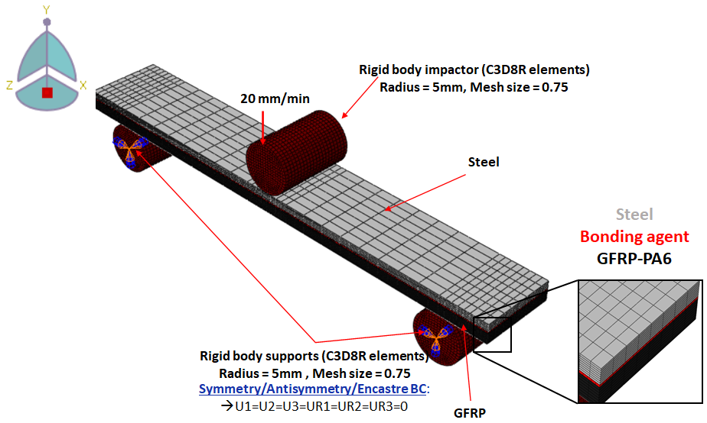
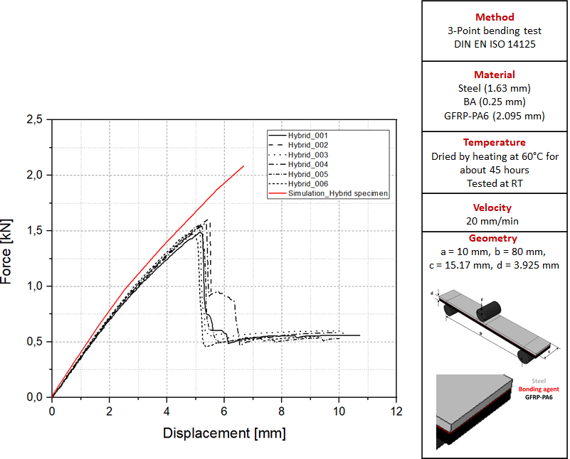
Structural test and its validation
The strength of the hybrid specimen is tripled whereas for the 3-PB of Steel specimen alone it withstands max.force of only 0.55 kN
There were some internal plasticity effects within GFRP which is also not modelled in the simulation

Slide 19
Contents
Hybrid plate overview and material model requirement
Workflow and Simulation principle
Hybrid plate process simulation
Structural test and its validation
Potential analysis in Toyota Camry
Conclusion and future work

Slide 20
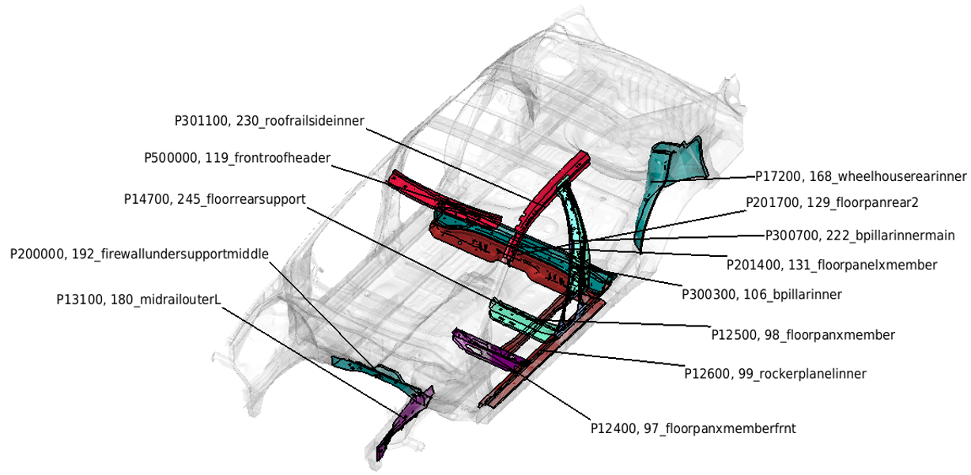
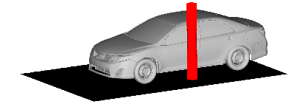




Potential analysis in Toyota Camry
Pole
ODB
Barrier
SOL
☑

Slide 21

Hybrid component in car model
3mm patch variant
Mass reduction of 0.52 kg/car
Version | Property name | Mass [kg] | Thickness [mm]
Basis | Floorpanelxmember | 2.09 | 2
V097 | Floorpanelxmember | 1.67 | 1.6
 | Patch | 0.163 | 3

Slide 22






Plasticity and Intrusion comparison
-375.23 mm
Basis
Basis
-368.37 mm
Patched variant
Patched variant

Slide 23


Spot weld failure comparison
Basis
Patched variant
Failures occur in time period of 15 ms
Failures occur in time period of 25 ms
Spotwelds were added additionally to enhance the strength

Slide 24


Adhesive failure comparison
Basis
Patched variant
Failures occur in time period of 45 ms
Failures occur in time period of 50 ms

Slide 25


Material failure comparison
Basis
Patched variant
Failures occur in time period of 60ms
Failures occur in time period of 55ms
Plasticity has slightly increased
Displacement has decreased by 6.8 mm
Spotweld failure has decreased and adhesive failure has slightly increased but remain on the lower level
Material failure is on the same level

Slide 26



Process simulation transfer – Thermal analysis results
Part with higher thickness cools slower than the part with lower thickness
Maximum temperature occurs in the region of the patch
Temperature distribution within GFRP is lower than the top part of Steel

Slide 27






Process simulation transfer – Mechanical analysis results
Load: Nodal temperatures from thermal analysis
No boundary condition has been applied
Overall displacement was found to be high with the maximum thickness patch as it cools down relatively slower
Maximum out-of-plane displacement of about 4.3 mm for 3 mm patch and 4.6 mm for 5 patch was found respectively

Slide 28


Process simulation transfer – Mechanical analysis results
The damage initiation criterion has already exceeded the maximum values in some areas
The patch thickness also plays an important role which leads to slightly different results

Slide 29
Contents
Hybrid plate overview and material model requirement
Workflow and Simulation principle
Hybrid plate process simulation
Structural test and its validation
Potential analysis in Toyota Camry
Conclusion and future work

Slide 30
Conclusion and scope for future work
Conclusion
A simulation method has been identified for the adapted process
A process history of the behavior of adhesive can be established
Different components can be analysed for the potential patching process so that weight reduction reduces cost and increases environmental benefits
Future work
An experimental verification of the fusion bonding incorporated adhesively bonded BIW components numerically calculated in this work is desirable
The mapping of the adhesive stiffness degradation from ABAQUS to PAM-CRASH solver must be done
It must also be validated for the different temperatures of the car which undergoes heating in the dryer from 23°C to 180°C

Slide 31
Thank you for your attention

Slide 32
References
Edmund Haberstroh and Michael Sickert. Thermal direct joining of hybrid plastic metal components. KMUTNB International Journal of Applied Science and Technology, Vol.7:29–34, 09 2014. doi: 10.14416/j.ijast.2014.07.002.
Robert Thomas, Fabian Fischer, and Maik Gude. Adhesives for increasing the bonding strength of in situ manufactured metal- composite joints. Proceedings of the Institution of Mechanical Engineers, Part D: Journal of Automobile Engineering, pages 1–14, 2020. doi: 10.1177/0954407020965759. URL https://doi.org/10.1177/0954407020965759.
Alexander Böttcher and Hermann Opdemom. Series-production adhesive process for hybrid components. Lightweight Design worldwide, Vol.12:48–53, 2019.
Larry.M. A guide to carbon fiber reinforced polymer repairs. 2016. URL https://www.vehicleservicepros.com/collision-repair/body-shop-and-repair/article/21191679/a-guide-to-carbon-fiber-reinforced-polymer-repairs
Claus-Peter Köth. Insight Automobilindustrie 2016 Leichtbau in der Automobilindustrie. Vogel Verlag. 2016.
Robert Georg Dietrich. Analyse der Wärmeausdehnungs-Inkompatibilität bei Klebverbindungen aus CFK, Stahl und Aluminium bei der Fertigung einer lackierten Karosserie. PhD thesis, Technische Universität München, Germany, 2017.
Theseus FE. https://www.theseus-fe.com/simulation-software/paint-dryer-simulation
Numerische abschätzung von eigenspannungen und bauteilverformungen in gesamtfahrzeugmodellen beim kleben im karosseriebau. Paderborner Symposium Fügetechnik (2006). https://www.theseus-fe.com/ths_content/publications/slides/20061129_slides_kleben-im-karosseriebau_prozess-simulation_de.pdf
Composite insert as a structural reinforcement for a-pillars. Continuousfiber- reinforced thermoplastic composites for lightweight car design, 10 2019. URL https://lanxess.com/en/Media/Press-Releases/2019/09/Composite-insert-as-a-structural-reinforcement-for-A-pillars

Slide 33
References
10. Leif Ickert, Dieter Thomas, Thomas Tröster, and Lutz Eckstein. Beitrag zum fortschritt im automobilleichtbau durch belastungsgerechte gestaltung und innovative lösungen für lokale verstärkungen von fahrzeugstrukturen in mischbauweise.
FAT-Schriftenreihe 244, (244), 2012.
11. Niklas Günther, Michael Griese, Elisabeth Stammen, and Klaus Dilger. Modeling of adhesive layers with temperature-dependent cohesive zone elements for predicting adhesive failure during the drying process of cathodic dip painting. Proceedings of the Institution of Mechanical Engineers, Part L: Journal of Materials: Design and Applications, 233:146442071880600, 10 2018. doi:
10.1177/1464420718806005.
12. Three point bend test fixtures URL https://www.instron.com/de-de/products/testing-accessories/flexure-fixtures/three-point-bend-test-fixtures?region=Germany
13. Muhammad Anas Athar M.Sc. Experimental values of the GFRP laminate. 2021.
14. Hexcel. Mechanical properties of Redux® 677.URL https://www.hexcel.com/user_area/content_media/raw/HexBond_677_DataSheet.pdf
[2021; accessed 20-July-2021].
15. Manuel Längauer, Franz Brunnthaller, Gernot Zitzenbacher, Christoph Burgstaller, and Christoph Hochenauer. Modeling of the anisotropic thermal conductivity of fabrics embedded in a thermoplastic matrix system. Polymer Composites, 42, 01 2021. doi: 10.1002/pc.25958.

Slide 34
References
16. Alexander Lion, Anton Matzenmiller, Gerson Meschut, Dominik Teutenberg, Patrick Kühlmeyer, and Christoph Liebl. Methodenentwicklung zur simulation und bewertung fertigungs- und betriebsbedingter klebschichtschädigungen
infolge temperaturwechselbeanspruchung. Forschungsvorhaben P878, Förderkennzeichen 369 ZN, 2014.
17. W. P. Goss. Thermal properties of wood and wood products.
18.David W. Green, Jerrold E. Winandy, and David E. Kretschmann. Mechanical properties of wood. wood handbook : wood as an engineering material. madison, wi : Usda forest service, forest products laboratory. General technical
report FPL ; GTR-113: Pages 4.1-4.45, 1999.
19.Young’s modulus: Modulus of elasticity of wood. URL https://amesweb.info/Materials/Youngs-Modulus-of-Wood.aspx [2021; accessed 20-July-2021].
20.Modulus of elasticity and Poisson’s coefficient of wood. URL https://www.sonelastic.com/en/fundamentals/tables-of-materials-properties/woods.html . [2021; accessed 20-July-2021].
21. Dušan Kecman. Bending collapse of rectangular and square section tubes. International Journal of Mechanical Sciences, Vol.25(9):623–636, 1983. ISSN 0020-7403. doi: https://doi.org/10.1016/0020-7403(83)90072-3. URLhttps://www.sciencedirect.com/science/article/pii/0020740383900723 Special
Issue Structural Crashworthiness Conference.

Slide 35
Appendix

Slide 36


Lightweight components
Hybrid A-pillar [3]
Hybrid front bumper [3]

Slide 37

Why cooling procedure?
Different variables during paint drying process

Slide 38






Why cooling procedure?
1
2
Heating phase
3
Holding phase
Adhesive fracture [3]
4
Cooling phase
Deformation
Cohesive failure
Adhesive failure
Adhesive crack [3]
[6]
Material failure
Highest stresses in adhesive layer occur during cooling because the adhesive is fully cured at this point and the relative displacements are just starting to decrease

Slide 39


Thermal-stress analysis
Two fields has to be determined in thermo-mechanical analysis
One field influences the other or both can influence each other
Load
Temperature
Displacement
An illustration of the sequentially coupled thermal-stress analysis
Can be solved by uncoupled heat transfer and then a displacement/stress analysis
In this problem, temperature does not depend on stress analysis
This is a common example of sequential multiphysics workflow

Slide 40


Steel plate cooling simulation
Cooling simulation model of the Steel component of the hybrid plate
Cooling simulation interpretation of Steel plate through a video

Slide 41



Support plate cooling experiment
Experimental Method
Free convective cooling of Support plate with Kapton tape
With Kapton tape(Thickness - 1.63 mm)
Support plate with Kapton tape
Steel
Material
Support plate With Kapton tape (Thickness - 1.73 mm)
Experimental duration
800 seconds
Temperature
Initial temperature – 180°C
Geometry & Measurement points
a = 300 mm, b = 240 mm
Cooling experimental setup for support plate of the hybrid plate

Slide 42




GFRP cooling experiment
Experimental Method
Free convective cooling of GFRP along with support plate
Method
Free convective cooling of CFRP
Material
Steel
GFRP (Thickness – 2.09 mm)
Support plate (Thickness – 1.743 mm)
Experimental duration
1200 seconds
Temperature
Initial temperature – 180°C
Geometry & Measurement points
a = 230 mm, b = 230 mm
c = 300 mm, d = 240 mm
e = 5 mm, f = 36 mm, g = 34 mm, h =45 mm Kapton tape
Cooling experimental setup for GFRP along with support plate of the hybrid plate

Slide 43

Cooling experiment for individual components
Steel
Support plate
GFRP
Cooling experiments for the individual components of the hybrid plate
Goal:
To record the temperature distribution of the individual components of the hybrid plate and to compare the results with FE results to obtain a justification

Slide 44



Steel cooling simulation setup
T2
T1
The temperatures were measured at exactly same points as that of the experiment to compare the results
T3

Slide 45
Material properties – Thermal analysis
 | Density [ton/mm³] | Thermal conductivity [mW/mm K] |  |  | Specific heat capacity [mJ/ton K]
Steel | 7.85e⁻⁹ | 52 |  |  | 0.48e⁹
GFRP _{[15]} | 1.6e⁻⁹ | k11 | k22 | k33 | 0.95e⁹
 |  | 4.5 | 0.67 | 0.67
Support plate | 7.85e⁻⁹ | 52 |  |  | 0.48e⁹
Adhesive_{[16]} | 1.2e⁻⁹ | 2 |  |  | 1.2e⁹
Wooden strip | 5.48e⁻¹⁰ | 0.14 |  |  | 1.63e⁹

Slide 46

Material properties – Mechanical analysis
 | Young’s modulus [MPa] | Poisson’s ratio | Thermal expansioncoefficient [K⁻¹]
Steel | 210000 | 0.3 | 1.3e⁻⁵
Support plate | 210000 | 0.3 | 1.3e⁻⁵
Wooden strip | 10000 | 0.4 | -
Temperature-dependent thermal expansion coefficient used for Bonding agent

Slide 47
Material properties – Mechanical analysis
Temperature dependent elastic properties of Bonding agent
Tensile, shear and energy release rates used for bonding agent [11]

Slide 48
Bilinear traction separation law
Temperature dependent behavior of cohesive zone elements [11]
Mechanical parameters of a bilinear traction separation law [11]

Slide 49

Material properties – Mechanical analysis
Temperature dependent elastic properties of GFRP
Thermal expansion coefficient of GFRP

Slide 50
Material properties – 3-point-bending
 | Young’s modulus [MPa] | Poisson’s ratio
Steel | 210000 | 0.3

Slide 51
Material properties – GFRP, Adhesive
Elastic properties used for GFRP [13]
Material parameters used for Redux 677 [14]
Tension |  |  | Shear
Modulus [MPa] | Strength [MPa] | Energy [mJ/mm²] | Modulus [MPa] | Strength [MPa] | Energy [mJ/mm²]
2500 | 50 | 1.5 | 860 | 50 | 1.5

Slide 52
Bending behavior
Bending collapse behavior of thin-walled structures [21]

Slide 53


3-point-bending results
Method
3-Point bending test
DIN EN ISO 14125
Material
DP980 (1.6 mm)
Temperature DP980_006 to 008 – With CDP process. Hardened by heating at 180°C for about 30 minutes
Tested at 18°C
Velocity
20 mm/min
Geometry
a = 10 mm, b = 80 mm, c = 15.05 mm, d = 1.6 mm

Slide 54


3-point-bending results
Method
3-Point bending test
DIN EN ISO 14125
Material
GFRP-PA6 (2.0 mm)
Temperature
Dried by heating at 80°C for about 15 hours
Tested at 20°C
Velocity
20 mm/min
Geometry
a = 10 mm, b = 80 mm, c = 15.07 mm, d = 2.0 mm

Slide 55

3-point-bending results

Slide 56


Industrial process
Overview of CDP dryer process
Importance of cooling phase
Heating zone
Cooling zone
Stepwise heating Stepwise cooling
Freshly painted car body positioned in paint-drying oven for curing [7]
Schematic representation of the temperature curve in a multi-material dryer process [6]
Aluminium/FRP
Steel
Deformation
[6]
Cohesive failure
Adhesive failure
[8]
Material failure
Different variables during paint drying process [11]
[6]

Slide 57


Hybrid plate process simulation – Mechanical analysis results
Steel adherend displaces in out-of-plane direction in production of DCB hybrid plate
An average of 45% stiffness degradation is found within the adhesive
Also, in many regions the damage initiation criterion had already exceeded which indicates that more damage is likely

Slide 58





Mechanical analysis
Increase in damage initiation criterion along GFRP material orientation direction 1

Slide 59



Process validation – Thermal analysis results
As expected the support plate tends to cool faster than the GFRP and has a temperature difference of about 3 degrees in the simulation

Slide 60



Process validation – Mechanical analysis results
The validation from the simulation falls short of the experimental value by about 0.06 mm

Slide 61

Process simulation transfer – Mechanical analysis results

Slide 62
Spot weld failure comparison
Patched variant
Failures occur in time period of 25 ms
Spotwelds were added additionally to enhance the strength

Slide 63
Adhesive failure comparison
Patched variant
Failures occur in time period of 50 ms

Slide 64





Process validation simulation
Scaled by a factor of 300

